Slide 1
Group Members Ali Hamza Usman Faisal Umair

Slide 2
Google Ads
And Monetization

Slide 3
Why need of ads in applications?
Reduce in purchase of paid apps
Source of earning for developers
Notes:
There was observed significant decrease in app purchase in recent years.
Developer obviously developing app to earn. So ads are good source

Slide 4
Revenue generation
Revenue is generated by the following formula
RPM = (Estimated earnings / Number of page views) * 1000
Notes:
By this formula, we can calculate expected revenue that we can earn through ads.

Slide 5
Types of Ads
Banner
Native
Rewarded
Interstitial

Slide 6
Banner ads
Rectangular ads that appear at the top or bottom of the device screen. Banner ads stay on screen while users are interacting with the app, and can refresh automatically after a certain period of time
Native ads
Customizable ads that match the look and feel of your app. You decide how and where they're placed, so the layout is more consistent with your app's design.
Notes:
Banner -> Rectangular ( top or bottom)
Native -> Customized

Slide 7
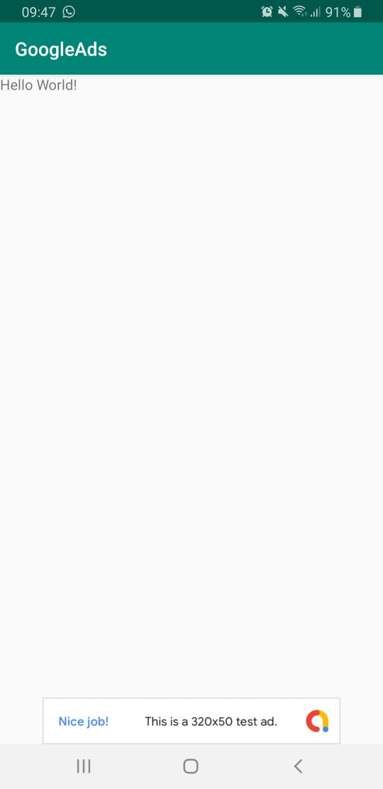
Banner ad

Slide 8
Interstitial ads
Full-screen ads that cover the interface of an app until closed by the user.
Rewarded ads
Ads that reward users for watching short videos and interacting with playable ads and surveys
Notes:
Interstitial -> Full Screen
Rewarded –> while playing game, if a user dies, he can watch the short video to earn a new life. So that it may continue his game.
Also, user is engaged to his app.

Slide 9
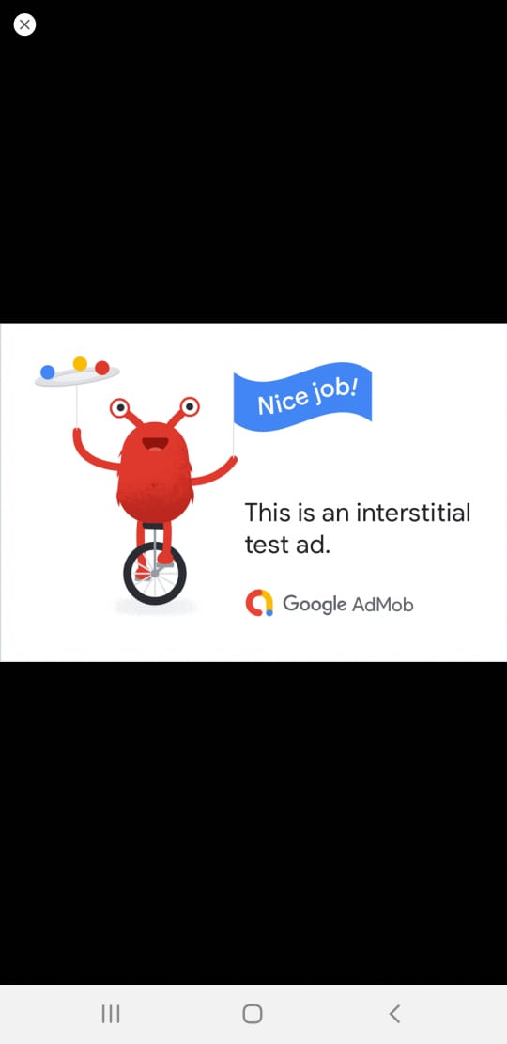
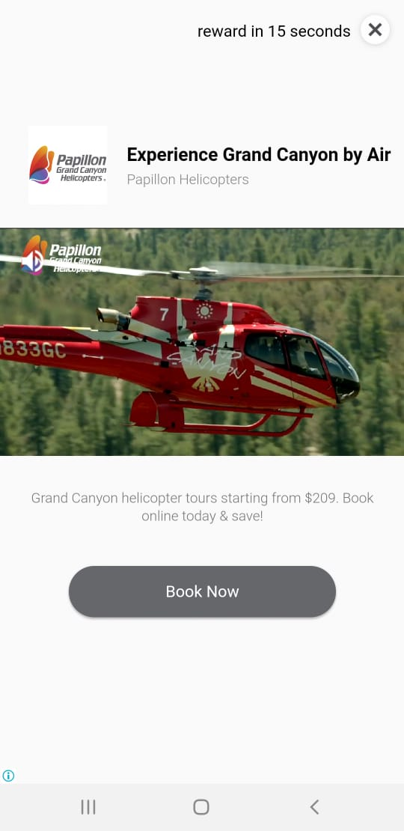
Interstitial and Rewarded

